Slide 1
Programming
Classes And OOP
Vassilis Markos
Mediterranean College
Week 09

Slide 2
Last Time’s Exercises

Slide 3
Before That…
Take a moment to help me design our revision materials according to your needs:
https://forms.gle/35JZhq9QD425xejs6
Responses are anonymous so feel free to be as sincere as possible!

Slide 4
Last Time’s Lab
Before we proceed with today’s materials, let us complete any work undone on last time’s lab. You can find it at:
source/Programming_Lab_04.pdf

Slide 5
Classes & Objects

Slide 6
Dogs
Think about dogs for a moment. What are some common things all (or most) dogs do on a daily basis?
  bark
  walk
  run
  produce “dog mess”
Write some python code that simulates the above!
For instance, barking could be simulated by a message print on screen, walking / running could be simulated by a variable indicating a dog’s location changing values etc.

Slide 7
Dogs
Open exm_01.py.
Read the code therein and try to understand how it works.
Play around with the main function (have your dog bark, run, walk or make some mess in various combinations).
Add any functionality you might find meaningful.
Now, based on that, try to model a two-dog interaction. Things dogs do when encountering other canines include:
  smelling each other
  barking at each other
  playing with each other
  …

Slide 8
Dogs
Do you have any comments to make on your code? Is it easy to understand for others?
What about having a dozen of dogs? What changes should you make for such a case to work properly?
How about naming your dogs? (Alice, Bob, Charlie, David etc) How would you do it?
What if you forget to name some dog? What should you do, then?
Some dogs are more social than others. How can you take that into account?
What dogs have to do with Python?

Slide 9
Classy Dogs
Open exm_02.py.
What do you see in there? Compare it to exm_01.py.
What does this class thing mean?
Don’t look at me! Open a browser and try to understand yourselves!
…
So, what is a class?
  Briefly, classes are abstractions of (real) entities incorporating relevant data and functionalities that help us put things together in a meaningful way.

Slide 10
Classy Dogs
What are some benefits of using classes?
  We have everything in one place.
  We avoid writing duplicate / similar lines of code.
  We can bind functionality to data (this is important!)
  We make our code easier to maintain (imagine having to change every single dog you have created to add a new feature…)
  We can do some (almost) real magic (stay tuned).
Extend the Dog class to allow them have a name (determined by users), and implement talking to, smelling, and playing with other dogs!

Slide 11
Classy Cats
What does a cat do as part of its daily routine?
  It is adorable (well…)
  It purrs
  It changes its fur
  It cleans itself
  It plays with itself
  …
Implement a python class named Cat that showcases some reasonable cat functionality.
You can find a sample implementation at exm_03.py.

Slide 12
Object Oriented Programming (OOP)
Using classes and all that stuff we have discussed so far is formally called Object Oriented Programming.
The idea is, as we said, that we bind functionalities to data.
A class in OOP is a description of an abstraction of some entity (e.g., the Dog and Cat classes we have designed so far).
An object in OOP is a specific instance of a class. You can think of classes as recipes and of objects as the specific instances of a recipe (that bolognese you made yesterday).
There are four main characteristics / benefits of OOP:
  Inheritance
  Data abstraction
  Encapsulation
  Polymorphism

Slide 13
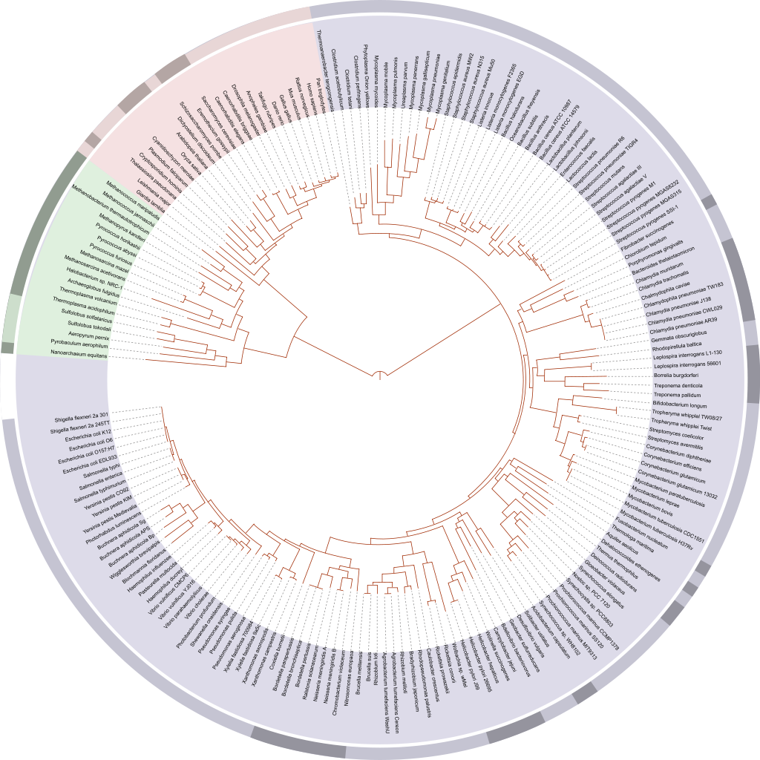
Time for Biology
This is a phylogenetic tree.
This is used to denote ancestry relationships between various species.
As you move closer to this tree’s root (here, in the centre of the graph) observe how you find common ancestors of several species.
We do something similar in programming…

Slide 14
Inheritance
In OOP we understand inheritance in a similar yet different way from biologists…
Think of the Cat and Dog classes we have implemented so far. What do they have in common:
  Both allow for self-playing as well as playing with others.
  Both allow for moving objects (through functions and corresponding object fields).
  Both allow for some sort of “talking”.
However, Cats and Dogs also have their differences:
  Dogs bark, cats purr (the also “meow”).
  Dogs walk and run, while cats don’t (at least, so far).
  Dogs produce mess, cats don’t.

Slide 15
Inheritance
In OOP we tend to factor out common functionalities + data in what we call Parent classes (or ancestor classes, in general).
In our case, we could design a Pet class, that contains all common functionalities and data fields of Dogs and Cats.
Actually, “we”, means “you”, so play around a bit with python and write a Pet class, as described above!
You can find a relevant implementation at exm_04.py.

Slide 16
Overwriting
In exm_04.py observe the Pet and Dog classes.
They both define a method named talk(). How does each work?
Consider the following script and explain its behaviour:
if __name__ == “__main__”:
alice = Pet(“Alice”)
bob = Dog(“Bob”)
alice.talk()
bob.talk()

Slide 17
Overwriting
When inheriting a class we can redefine any method or field we want to. This is called overwriting.
This is useful because, in many cases, there is a quasi-default behaviour for most child classes, but not for all. This is when overwriting shines.
Some key takeaways about overwriting:
  Overwriting a method in a child class does not change its parent’s implementation.
  An overwriting a method can still call its parent’s very same method, if needed.

Slide 18
Polymorphism
What will this print? (exm_05.py)
from exm_04 import Pet, Dog, Cat
def main():
alice = Dog("Alice")
print(f"Is {alice.name} a dog? {isinstance(alice, Dog)}.")
print(f"Is {alice.name} a cat? {isinstance(alice, Cat)}.")
print(f"Is {alice.name} a pet? {isinstance(alice, Pet)}.")
if __name__ == "__main__":
main()

Slide 19
Polymorphism
Polymorphism: The situation where “a thing” is like “many things”.
For instance, in the above:
  Cats are also Pets.
  Dogs are also Pets.
  Dogs are not Cats or vice versa.
How can we access a parent method from a child instance in python?
  E.g., how can we make alice (a Dog) talk() like a Pet?
Look around the web for that!
The answer is… [drum roll]
  We can’t.
This is important if it happens to know some other OOP language (e.g., Java).

Slide 20
Encapsulation & Data Abstraction
Encapsulation [Take 1]: A fancy word to confuse you.
Encapsulation [Take 2]: The act of binding functions / methods with data together.
  E.g., a dog (datum) can bark (action → function).
Data Abstraction: The act of keeping things at a higher level, hiding lower-level details.
Revisit exm_05.py without taking a look at exm_04.py.
  How are dog implemented in the background?
  You don’t know! (abstraction: the lower level is hidden from you)
  How does class Cat implement Cat.play()?
  You don’t know! (abstraction: the lower level is hidden from you)
  You can treat Pet, Dog and Cat as black boxes offering some functionality.

Slide 21
Class-ic Fun
Do not execute the file below! (Uhm… Which file?)
Open and study exm_06.py.
What is going on in there? What will it print?
Take your time, don’t rush!
Okay, now you can run the script.
[break to get sufficiently surprised]
What did happen?
Can you explain it?

Slide 22
Class-ic Fun
bob:
What we have…
bob:
bob.name
bob.name
another_bob is just a different object living somewhere else in memory. For python objects, a == b just compares memory locations, so it yields False!
bob.location
bob.location
<other bob stuff>
<other bob stuff>
…
…
another_bob:
another_bob:
another_bob.name
I am the same
<another_bob stuff>
What we want…
as bob!

Slide 23
Python Magic Functions
Python classes offer what is known as magic functions.
Look around the web to find out what they are.
[waiting for you to find out what they are]
So, which function can help us make bob and another_bob the same?
There is a popular magic function, __eq__(), which determines when two objects are the same.
Try to use it to overwrite the default behaviour of == with python objects.

Slide 24
Class-ic Fun
bob:
What we have…
bob:
bob.name
bob.name
charlie = bob just creates a reference from charlie to bob, so any change on either is reflected on both!
bob.location
bob.location
<other bob stuff>
<other bob stuff>
…
…
charlie
charlie:
point to bob
charlie.name
What we want…
<other charlie stuff>

Slide 25
Homework
This is a self-study exercise on python classes. You have to follow the tutorial found below:
https://realpython.com/python-classes/
Observe all code found there and try it yourself (i.e., copy-paste it and run it locally). This will give you a really in depth starter on python classes.
Contact me for any questions at: v.markos@mc-class.gr

Slide 26
Fun Time!

Slide 27
Time for revision!
Start working on the exercises found in the ‘source/portfolio’ directory.
You can use any resources you want wisely!
Submit all your work on this Google Form once you are done (soft deadline: Friday, 20/12/2024):
https://forms.gle/LSiNr4Rx5LNxUfjVA

Slide 28
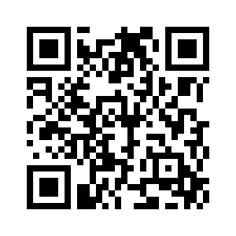
Any Questions?
Don’t forget to fill-in the questionnaire! (check right)
https://forms.gle/zezKMVzhaT4xyJgk8

